Slide 1

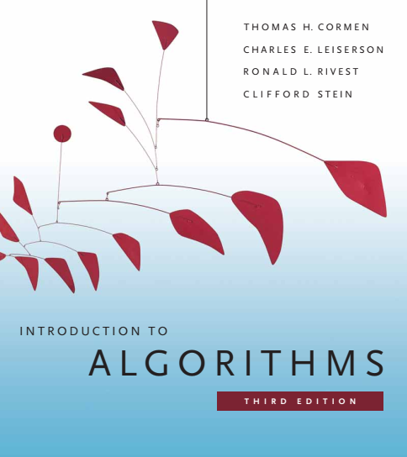
Design and Analysis of Algorithms
Dr. Sajid Iqbal
sajidiqbal.pk@gmail.com
Reference Book
Introduction to Algorithms 3rd Edition By Thomas H. Cormen et. al.
https://mitpress.mit.edu/books/introduction-algorithms-third-edition
COMEDXD

Slide 2
The Quick Sort
Application of Divide and conquer method

Slide 3

Background
Quicksort has worst case running time of $θ\left(n^{2}\right)$
Its average case running time is $θ\left(nlogn\right)$ with small constants
Hence is usually best choice for sorting
It is inplace sorting technique
It works well in virtual environment

Slide 4
Background
Break the problem into a number of subproblems that are smaller instances of the same problem
Conquer
Solve the sub-problems recursively. Solve the smallest problems directly
Combine
Combine the solutions to the subproblems into the solution for the original problem
Divide
Divide-n-Conquer consists of three phases

Slide 5
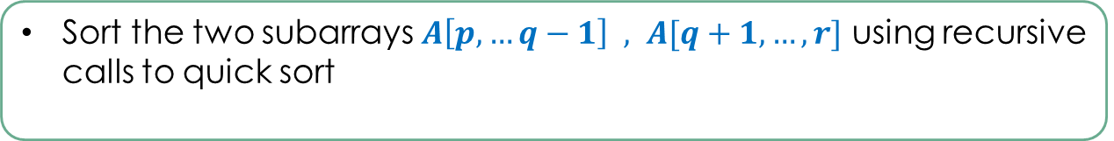
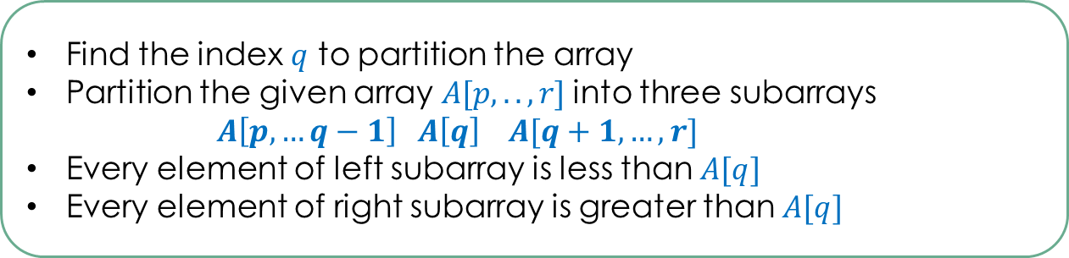
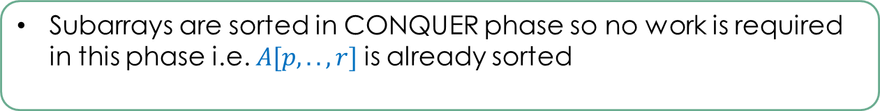
Introduction
DIVIDE
Find the index $q$ to partition the array
Partition the given array $A[p,..,r]$into three subarrays
$$A\left[p,…q−1\right] A\left[q\right] A[q+1,…,r]$$
Every element of left subarray is less than $A[q]$
Every element of right subarray is greater than $A[q]$
CONQUER
Sort the two subarrays $A\left[p,…q−1\right] , A[q+1,…,r]$ using recursive calls to quick sort
COMBINE
Subarrays are sorted in CONQUER phase so no work is required in this phase i.e. $A[p,..,r]$is already sorted

Slide 6
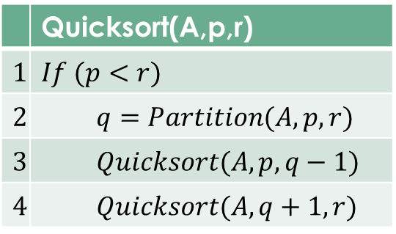
The Quicksort (QS) Algorithm
At line 1, QS checks if there are more than 0 elements in the array
Partition sub-routine breaks the array into two parts
QS recursively solves the left part of array and right part of array
The sorting logic lies in Partition part.
 | Quicksort(A,p,r)
$$1$$ | $$If (p<r)$$
$$2$$ | $$q=Partition(A,p,r)$$
$$3$$ | $$Quicksort(A,p,q−1)$$
$$4$$ | $$Quicksort(A,q+1,r)$$

Slide 7

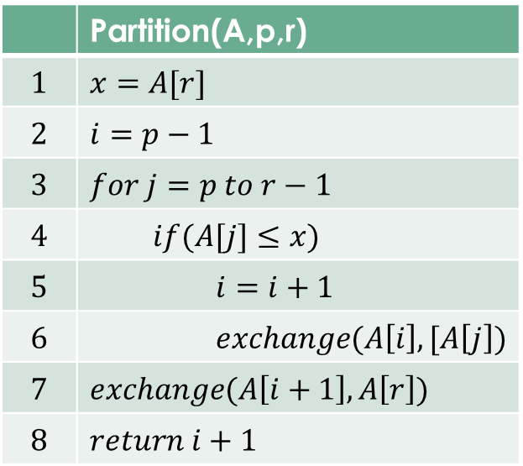
Partitioning the Array
Line 1 copies the last array element into $x$
Line 2 the index I starts with $p−1$ element
Line 3 the loop iterates from first element to second last element of the array
If the indexed element is less than or equal to $x$
Index $I$ is incremented
$J^{th}$ array element is exchanged with $i^{th}$ element
The process continues and at end of loop ${\left(i+1\right)}^{th}$ element is exchanged with $r^{th}$ element. Line 7 puts the pivot element to its correct position
$i+1$ is returned which is partition point i.e. $q$
 | Partition(A,p,r)
$$1$$ | $$x=A[r]$$
$$2$$ | $$i=p−1$$
$$3$$ | $$for j=p to r−1$$
$$4$$ | $$if(A[j]≤x)$$
$$5$$ | $$i=i+1$$
$$6$$ | $$exchange(A\left[i\right],[A\left[j\right])$$
$$7$$ | $$exchange(A\left[i+1\right],A\left[r\right])$$
$$8$$ | $$return i+1$$

Slide 8
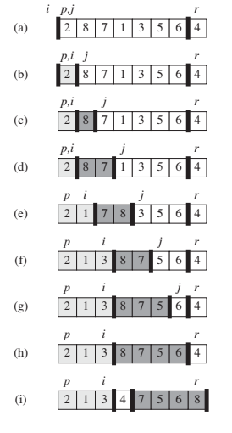
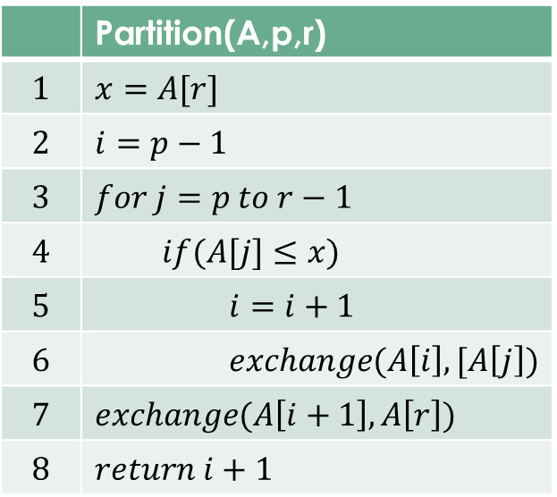
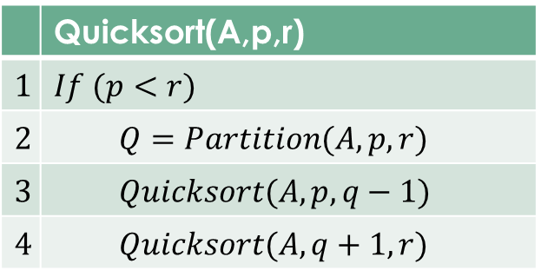
Quick Sort Illustration
 | Quicksort(A,p,r)
$$1$$ | $$If (p<r)$$
$$2$$ | $$Q=Partition(A,p,r)$$
$$3$$ | $$Quicksort(A,p,q−1)$$
$$4$$ | $$Quicksort(A,q+1,r)$$
 | Partition(A,p,r)
$$1$$ | $$x=A[r]$$
$$2$$ | $$i=p−1$$
$$3$$ | $$for j=p to r−1$$
$$4$$ | $$if(A[j]≤x)$$
$$5$$ | $$i=i+1$$
$$6$$ | $$exchange(A\left[i\right],[A\left[j\right])$$
$$7$$ | $$exchange(A\left[i+1\right],A\left[r\right])$$
$$8$$ | $$return i+1$$

Slide 9







Loop Invariant
At the start of each iteration of the loop of lines 3-6, following properties remain true
If $p≤k≤i,$ then $A[k]≤x$
If $i+1≤k≤j−1,$ then $A[k]>x$
If $k=r,$ then $A\left[k\right]=x$
$$p≤k≤i$$
$≤x$ $≤$
$$i+1≤k≤j−1$$
$$j≤k≤r−1$$
$$A\left[k\right]=x$$
The indices between$j$and $r − 1$are not covered by any of the three cases, and the values in these entries have no particular relationship to the pivot $x$

Slide 10
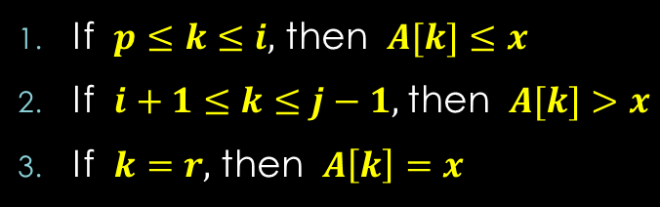

Loop Invariant
Initialization:
Prior to the first iteration of the loop, $i=p−1,j=p$.
No values lie between $p$ and $I$
No values lie between $i+1$ and $j−1$
Line 1 satisfies the $3rd$ condition

Slide 11
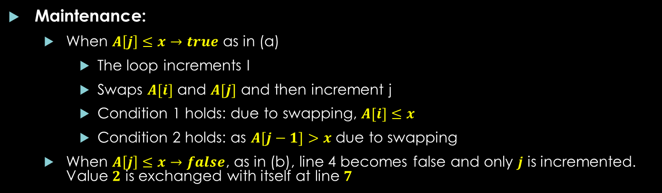
Loop Invariant
Maintenance:
When $A\left[j\right]≤x→true$ as in (a)
The loop increments I
Swaps $A[i]$ and $A[j]$ and then increment j
Condition 1 holds: due to swapping, $A[i]≤x$
Condition 2 holds: as $A[j−1]>x$ due to swapping
When $A\left[j\right]≤x→false$, as in (b), line 4 becomes false and only $j$ is incremented. Value $2$ is exchanged with itself at line $7$
What type of induction this is?
Strong or weak?

Slide 12
Loop Invariant
Termination:
At termination j=r.
Every entry in the array is in once of the three sets as given by loop invariant
Values less than or equal to x
Values greater than x
Singleton set containing x

Slide 13
Python Implementation of QuickSort
def Quick_Sort(A, p, r): if p < r: q = Partition(A, p, r) Quick_Sort(A, p, q-1) Quick_Sort(A, q+1, r)
def Partition(A, p, r): x = A[r] i = p-1 for j in range(p, r): if A[j] <= x: i = i+1 A[i], A[j] = A[j], A[i] A[i+1], A[r] = A[r], A[i+1] return (i+1)
# Driver code A = [2, 8, 7, 1, 3, 5, 6, 4] p = 0 r = len(A) Quick_Sort(A, p, r-1) print("Array after quick sort..:") print(A)

Slide 14

Thanks for watching
Dr. Sajid Iqbal
Assistant Professor
Department of Computer Science
Bahauddin Zakariya University, Multan
sajidiqbal.pk@gmail.com
YouTube Channel: COMEDXD
Allah Hafiz

